Slide 1
Intro to AVR ATMega16 and Parallel I/O
Lecture 3

Slide 2
8 bit MicroController
Data bus is 8 bits
There are 16-bit registers or registers that store 16 bit data
The 16-bit register is then accessed by a 8 bit data bus through 2 read or write operations

Slide 3
AVR ATMega16 Memory
16 KB on chip Reprogrammable flash memory for Program Storage
  Endurance of 10,000 read/write cycles
  Organized as 8K X 16 bits
  Program memory address ranges from 000 to 1FFF
1120 data memory locations
  Address Registers, I/O memory and internal data SRAM
  First 96 address I/O and Registers
  Last 1120-96 addresses internal data SRAM
  32 general purpose working registers, 64 I/O registers and 1024 bytes of internal data SRAM for ATMega16

Slide 4
AVR ATMega16 Memory
512 bytes of EEPROM
  Will come to this later
I/O space
  32 general purpose registers
  64 registers for I/O that control peripherals such as timers, ADC etc
  Page 331 of the ATMega16 user’s manual lists the 64 registers that are used for interfacing peripherals

Slide 5
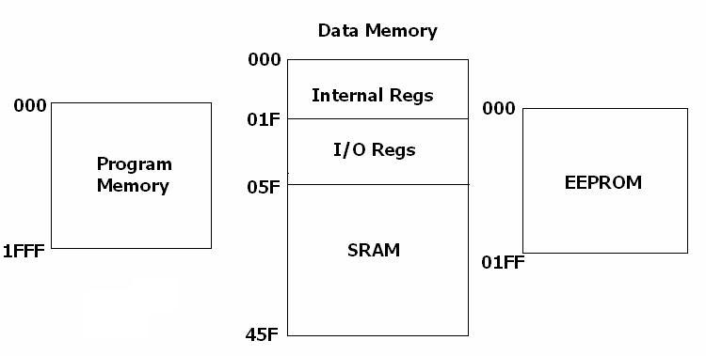
Memory Map of ATMega16

Slide 6
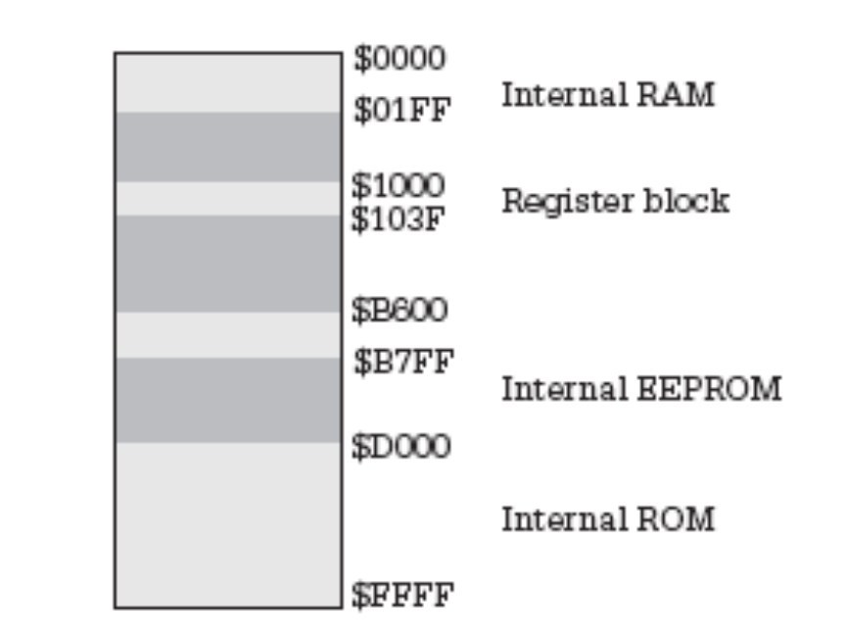
Memory Map of 68HC11

Slide 7
Architecture
The Central Processing Unit (CPU) is connected to the other subsystems of the microcontroller by means of the address and data buses.
Depending on how the CPU accesses the program memory, there are two possible architectures for microcontrollers, called Von Neumann, and Harvard.

Slide 8
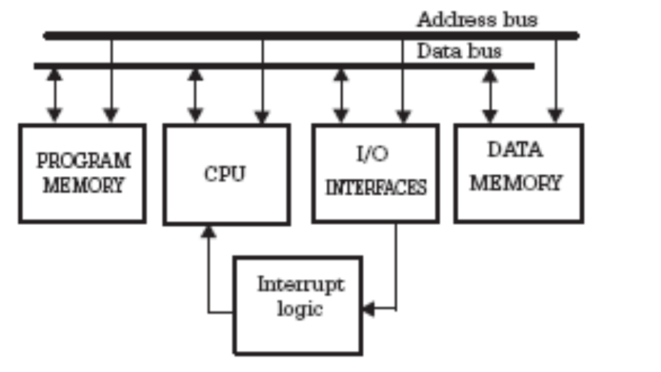
Architecture: Von Neumann
Figure shows the structure of a controller with Von Neumann architecture,
where all the resources, including program memory, data memory, and I/O registers, are connected to the CPU by means of a unique address and data bus.
The CPU can be either reading an instruction or reading/writing data from/to the memory. Both cannot occur at the same time since the instructions and data use the same bus system.
A typical microcontroller having Von Neumann architecture is 68HC11 from
Motorola. In HC11, all resources are identified by unique addresses in the same
address space, and can be accessed using the same instructions.

Slide 9
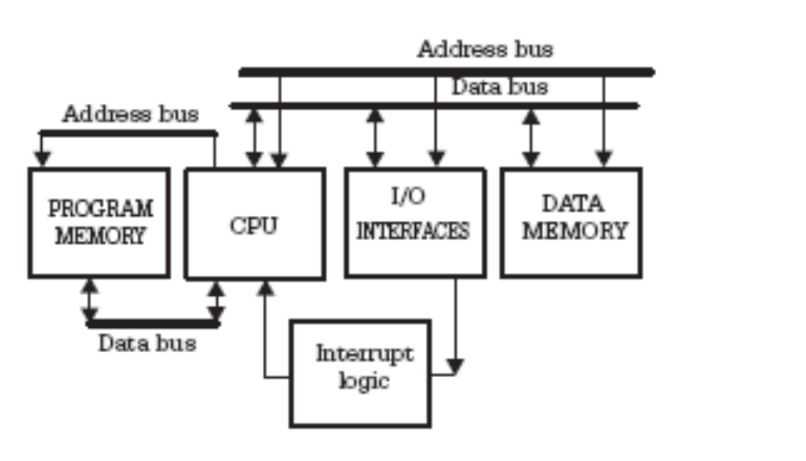
Architecture: Harvard
Harvard architecture includes an additional, separate bus to access the program memory (refer to Fig.).
The presence of the second bus makes the following things possible:
• While an instruction is executed, the next instruction can be fetched from the
program memory. This technique is called pipelining and brings a significant
increase of computer speed.
• The program memory can be organized in words of different size from, and
usually larger than, the data memory. Wider instructions mean a greater data flow to the CPU, and therefore the overall speed is higher.

Slide 10
Architecture: CISC
The primary goal of CISC architecture is to complete a task in as few lines of assembly as possible.
Let's say we want to find the product of two numbers - one stored in location 2:3 and another stored in location 5:2 - and then store the product back in the location 2:3.
For this particular task, a CISC processor uses the MULT instruction. When executed, this instruction loads the two values into separate registers, multiplies the operands in the execution unit, and then stores the product in the appropriate register. Thus, the entire task of multiplying two numbers can be completed with one instruction:
MULT 2:3, 5:2

Slide 11
Architecture: RISC
RISC processors only use simple instructions that can be executed within one clock cycle. Thus, the "MULT" command described above could be divided into three separate commands: "LOAD," which moves data from the memory bank to a register, "PROD," which finds the product of two operands located within the registers, and "STORE," which moves data from a register to the memory banks. In order to perform the exact series of steps described in the CISC approach, a programmer would need to code four lines of assembly:
LOAD A, 2:3
LOAD B, 5:2
PROD A, B
STORE 2:3, A

Slide 12
AVR ATMega16 Architecture
Harvard architecture
  Simultaneous access of program instructions and data are possible through separate memories and buses for both
RISC Architecture
  one cycle execution time: RISC processors have a CPI (clock per instruction) of one cycle. This is due to the optimization of each instruction on the CPU and a technique called ;
  pipelining: a techique that allows for simultaneous execution of parts, or stages, of instructions to more efficiently process instructions;
  large number of registers: the RISC design philosophy generally incorporates a larger number of registers to prevent in large amounts of interactions with memory

Slide 13
Interrupts
21 different interrupts mapped to 21 successive locations in the program memory space
Starting address of the interrupt depends on the combinations of BOOTRST and IVSEL settings
Two of the interrupts are due to external requests others are due to timers, I2C bus, USART, ADC and other peripheral devices

Slide 14
Peripherals
Two 8 bit Timers/ Counters
One 16 bit timer/ counter
10 bit ADC
Analog Comparator
Two wire interface (I2C bus)
  Connects to external devices that talk through this bus, for eg SRF-04 sonar rangers
SPI serial interface
  A serial protocol/ standard for talking to external devices, developed by Motorola. Analog devices’ accelerometers use this interface
Programmable serial USART

Slide 15
Some useful links
http://www.nongnu.org/avr-libc/user-manual/group__demos.html
http://www.nongnu.org/avr-libc/user-manual/index.html

Slide 16
Objective
To learn how to use I/O ports, to write values to port pins and read values from them

Slide 17
Applications
Any digital I/O applications or digitized I/O applications
Writing to LED or activating/enabling external circuits by writing a high or low to them
Reading states of sensors (occurrence or non occurrence of an event) such as bump sensors, TSOP etc

Slide 18
Ports and Port Pins
4 I/O ports: Port A, B, C, D also denoted as PA, PB, PC, PD
Each port has 8 lines that can be independently set as H/L
Each of the 8 lines can be configured independently as an input or an output pin
The above feature is called True Read Modify Write Functionality
Pin drivers are strong enough to drive LEDs directly
All pins have voltage invariant internal pull up resistors
Each of them can be individually pulled up as H/L

Slide 19
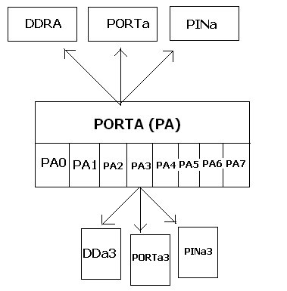
Registers Associated With Ports
Each port is associated with 3 registers: The data registers (PORTa), the data direction register (DDRa) and the Input pin register (PINa)
Each port pin, PA3 for eg, is associated with 3 pins: DDa3, PORTa3, PINa3
While programming the letters are capped.

Slide 20
Configuring PINS
If DDa3 is high (H) then pin 3 of PORTA (PA) is output else its an input
If DDa3 is H and PORTa3 is H then pin 3 of PA is H (sources current) else if PORTa3 is L then pin 3 of PA is L (sinks current)
If DDa3 is L then pin 3 of PA is input
  If PORTa3 is L then pin 3 of PA (PA3) is tri stated/ undefined
  If PORTa3 is H and PUD is L then pin 3 of PA (PA3) is pulled up
  If PORTa3 is H and PUD is H then PA3 is tri stated or undefined

Slide 21
Reading the PIN
Independent of the settings of DDa bits the PA3 pin can be read from PINa3 bit
PINx can be only read the other 2 registers can be read from or written to.

Slide 22
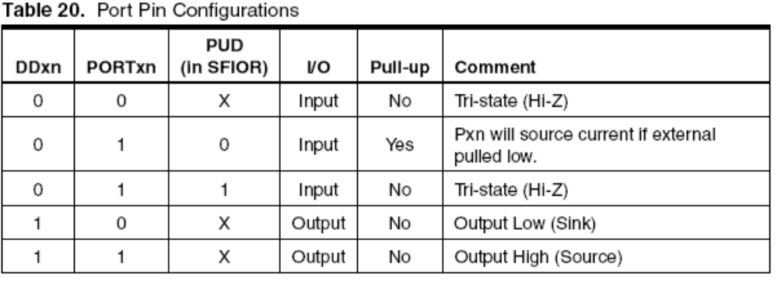
Truth Table

Slide 23
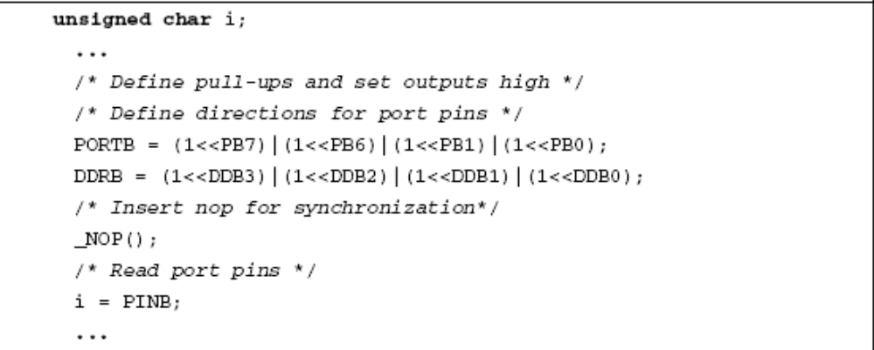
An Example
PB0 = output High (OH), PB1 = OH, PB2 = OL, PB3 = OL
PB4 = PB5 = input tristated, PB6 = PB7 = input (pulled up). Note by default PUD is low

Slide 24
Tristate and Pullups
When a pin is tristated its undefined. Reading it when tri-stated can result in garbled values
Best to use tristate when an external circuit needs to input both H or L to the port and provides one of the two inputs at all instants of UC operation
When the internal pull-up is not activated, the default value at the pin is undefined (High Z). For giving input, generally we connect a resistor from Vcc to the input pin, and a switch from the pin to Gnd. When the switch is not pressed, almost zero current flows through the resistor, and hence the pin reads a high(Vcc). When the switch is pressed, the voltage at the pin goes to zero and the pin reads a low.
When the internal pull-up is activated, the external resistor appears internally. So the default value at the pin is high, and it goes to low when a switch is used to short the pin with Gnd.
The last two bulleted statements are when switches are used for inputs such as bump sensor inputs

